Slide 1
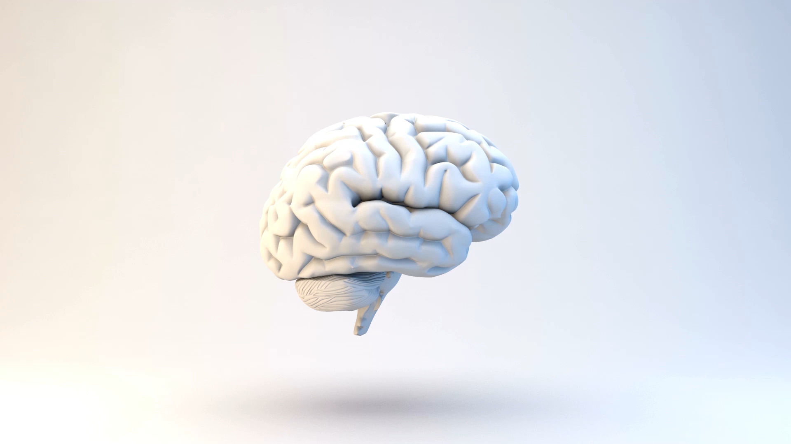
Brain Tumour Prediction
Image classification using Machine Learning
Rechel Thomas Rebello
Priyal Hetalkumar Patel
Karan Boghara
Mahima Gupta
Navjot Kaur

Slide 2
Content
Issues
Problem Statement
EDA
Modeling
Conclusion
Deployment
Future Work
References
Introduction
Dataset description

Slide 3
Introduction
Brain tumours are growths of abnormal cells in the brain that can become malignant and life-threatening due to the changes they cause to the vital structures of the brain.
The accurate and timely diagnosis of brain tumours is crucial for effective treatment
and improving patient survival rates.

Slide 4




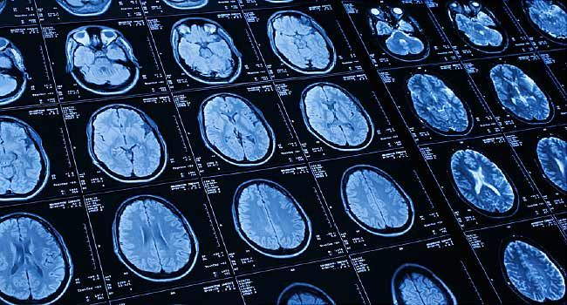
Issues
SHORT SUPPLY OF MEDICAL STAFF
COST OF NEUROLOGIST
TIMELY AND EXACT DETECTION OF TUMOR
LARGE VOLUME OF DETECTIONS

Slide 5
Problem Statement
By utilizing machine learning models to analyze large volumes of medical images,
medical professionals can detect brain tumours accurately, reducing the risk of misdiagnosis and improving patient outcomes.

Slide 6



Stakeholder analysis
Patients
Medical community
Government

Slide 7
Data Description
The dataset aims to classify brain tumors into FOUR distinct categories: Glioma, Meningioma, Pituitary and No – Tumor.
The dataset contains a total of 3264 images, with each category having a different number of images.
Class | Number of Images
Meningioma | 937
Glioma | 926
Pituitary | 901
No - Tumor | 500

Slide 8
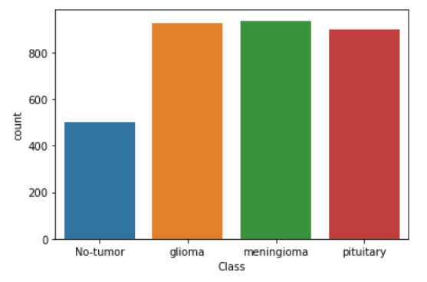
Exploratory Data Analysis

Slide 9
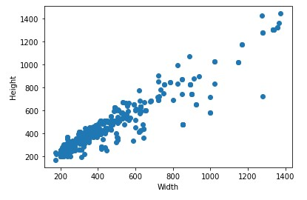
Distribution of Image's height and width
We resize the images with height from 250 and width with 250.

Slide 10
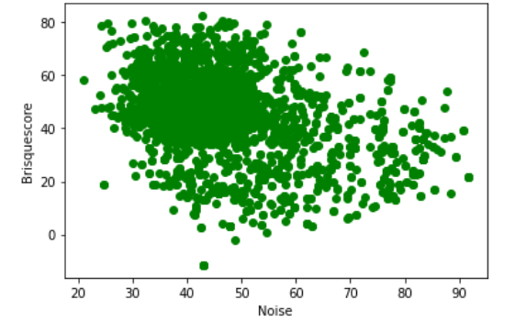
Noise and Brisquescore

Slide 11
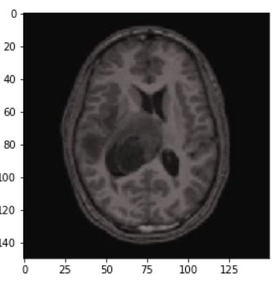
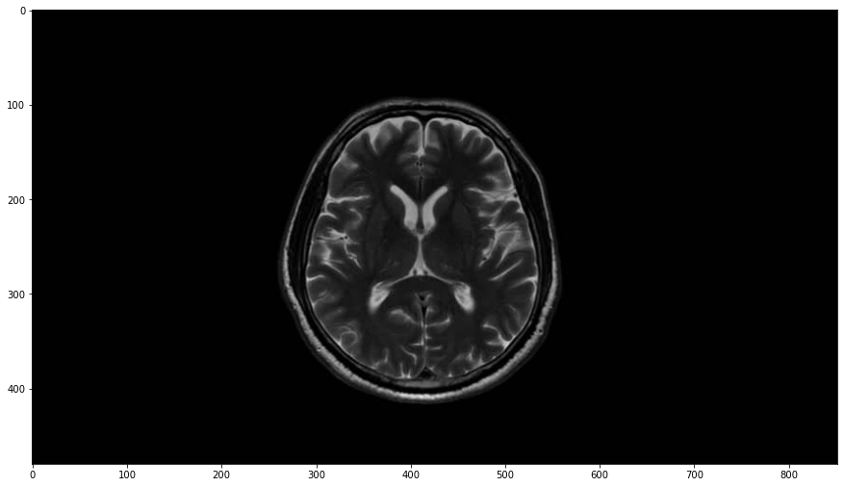
Example of Noise

Slide 12
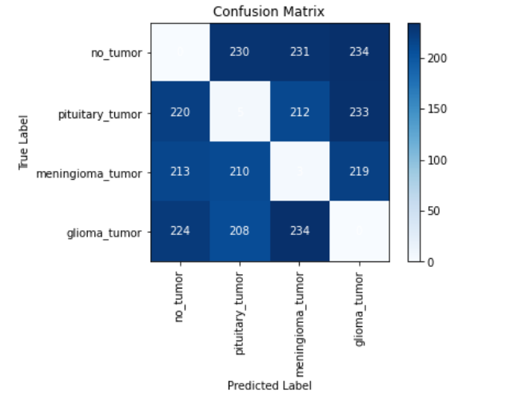
Random Forest Multiclass
The confusion matrix shows that the This is reflected in the very low accuracy score of 0.002, which means that the model is correctly predicting the class of the target variable only 0.3% of the time.

Slide 13
Convolutional Neural Network(CNN)
The report suggests that the model performed well for some classes but identifying all positive cases for certain classes.
Class | Precision | Recall | F1- score
Glioma | 1 | 0.17 | 0.29
Meningioma | 0.69 | 0.77 | 0.72
No tumour | 0.53 | 1 | 0.69
Pituitary | 0.74 | 0.27 | 0.40
Accuracy is 0.882

Slide 14
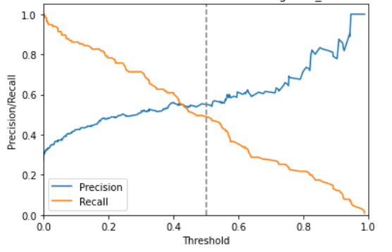
Precision – Recall Curve
The precision-recall curve has a threshold of 0.43,
which means that any point with a predicted probability more than or equal to 0.43 is positive,
while any point with a forecasted probability less than 0.43 is negative.

Slide 15
Results

Slide 16
CONCLUSION
Overall, the results of this analysis suggest that the CNN model with multiclassification is the most effective tool for accurately detecting brain tumours.
This information can be useful for medical professionals in making accurate diagnoses and improving patient outcomes.

Slide 17


Deployment
To deploy the application, a basic Streamlit script was loaded the CNN model and provided users with an interface for uploading brain scans to be analyzed.
The application was complete, it is hosted on Amazon web service, which allowed us to make it accessible to users from anywhere with an internet connection.

Slide 18
Web Application Demo
https://drive.google.com/file/d/1HzFPBfzAtXwuVCF0bozOah3onYkcIdel/view?usp=sharing

Slide 19
Future Work
Research
The ‘Other’ category can be researched to understand the kind of cases contained in this class.
Enhance
Collection of more brain tumour images for enhancing classification model’s performance.
Validate
Validating model performance with biopsy and pathology reports.
Expand
Scope expansion by including more tumour other than glioma, Meningioma and Pituitary.

Slide 20
References
[1]https://www.hindawi.com/journals/ijbi/2017/9749108/
[2]https://www.pennmedicine.org/news/news-releases/2022/december/ai-enables-the-largest-brain-tumor-study
[3]https://www.hopkinsmedicine.org/health/conditions-and-diseases/brain-tumor
[4]https://mayfieldclinic.com/pe-braintumor.htm
[5]https://www.mayoclinic.org/diseases-conditions/brain-tumor/symptoms-causes/syc-20350084
[6]https://www.cancerresearchuk.org/about-cancer/brain-tumours/types
[7]https://www.cancer.org/cancer/brain-spinal-cord-tumors-adults/about/types-of-brain-tumors.html
[8]https://www.pennmedicine.org/updates/blogs/neuroscience-blog/2018/november/what-are-the-most-common-types-of-brain-tumors
[9]https://www.kaggle.com/datasets/sartajbhuvaji/brain-tumor-classification-mri
[10]https://github.com/sartajbhuvaji/brain-tumor-classification-dataset
LINK FOR GITHUB
https://github.com/rechelrebello/Brain-tumor-detection

Slide 21
THANK YOU

